Slide 1
Performance Analysis of Reinforcement Learning for Robot Tasks with GPU Acceleration NVIDIA Isaac Lab
Ruben Noroian
EECE5640 Final Project

Slide 2
Motivation
I am involved in robotics research, lab members are introducing RL training into legged locomotion control
RL is emerging as a valuable method to enable autonomy, with Boston Dynamics, Google DeepMind are among companies leading R&D efforts
Training for complex tasks can be time consuming and wasteful, efficiency is important

Slide 3
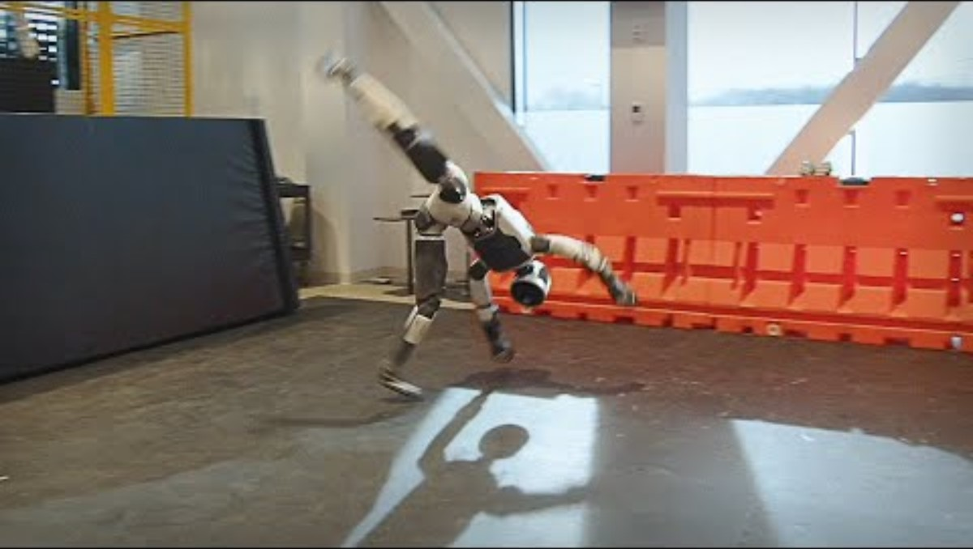
https://www.youtube.com/watch?v=I44_zbEwz_w

Slide 4
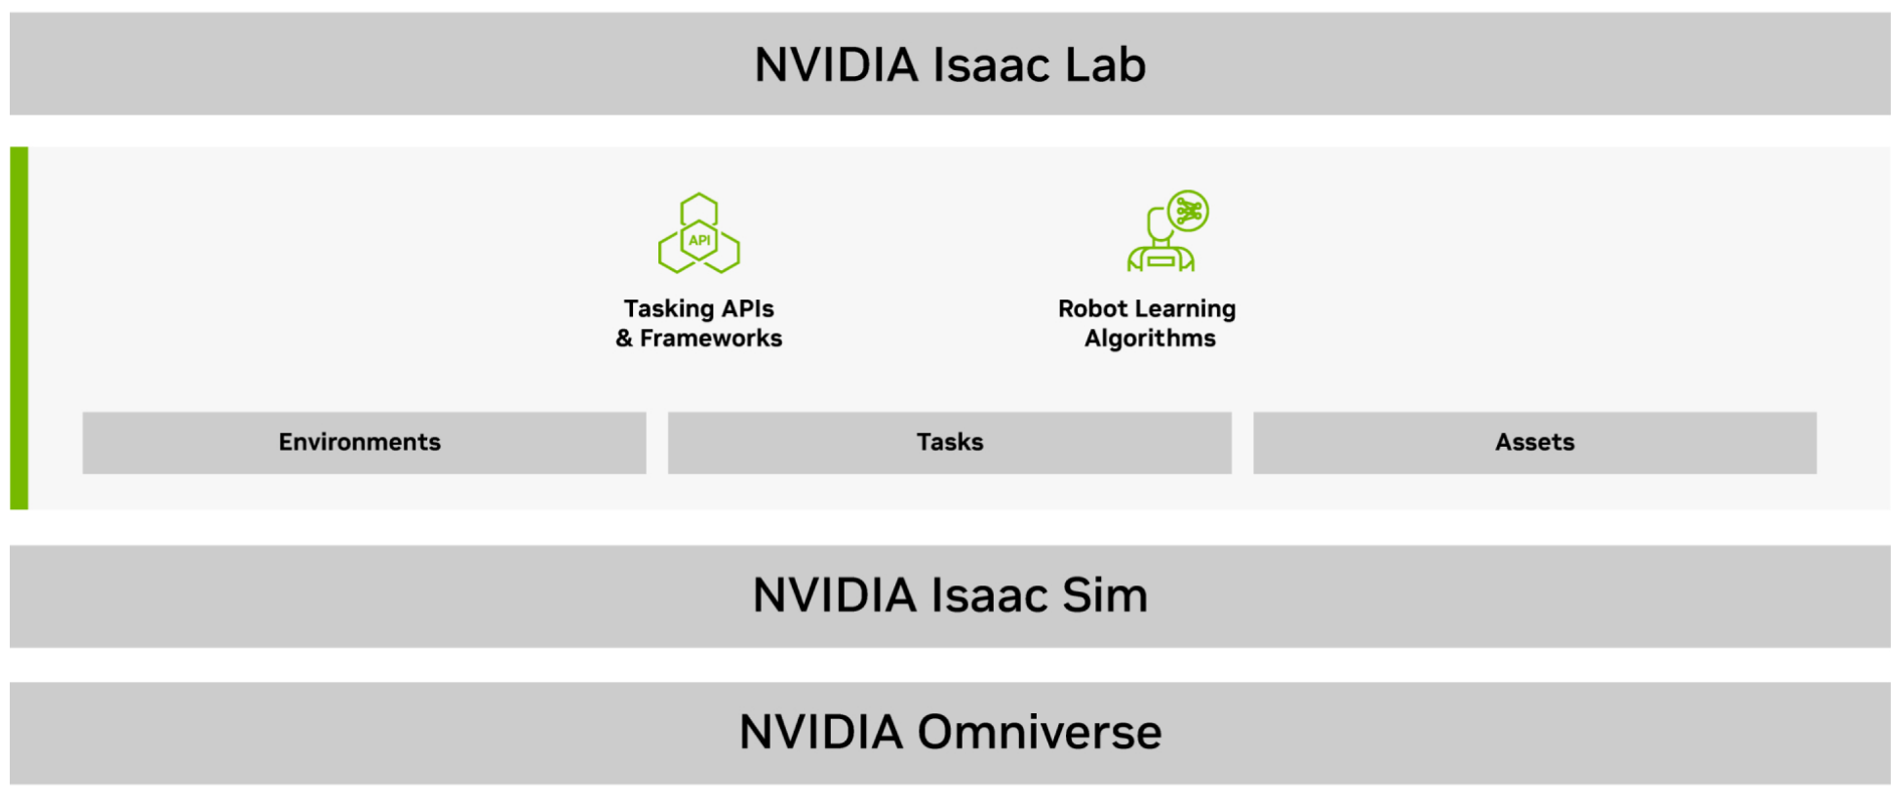
Isaac Lab & NVIDIA's Platforms
Isaac Lab is built on Isaac Sim and Omniverse
Omniverse is a simulation platform for 3D "digital twins"
Isaac Sim is a physics-based simulation (RTX) toolkit for modeling robots
Isaac Lab is a framework for workflow simplification with RL
Support several RL frameworks, algorithms, and provides training examples

Slide 5
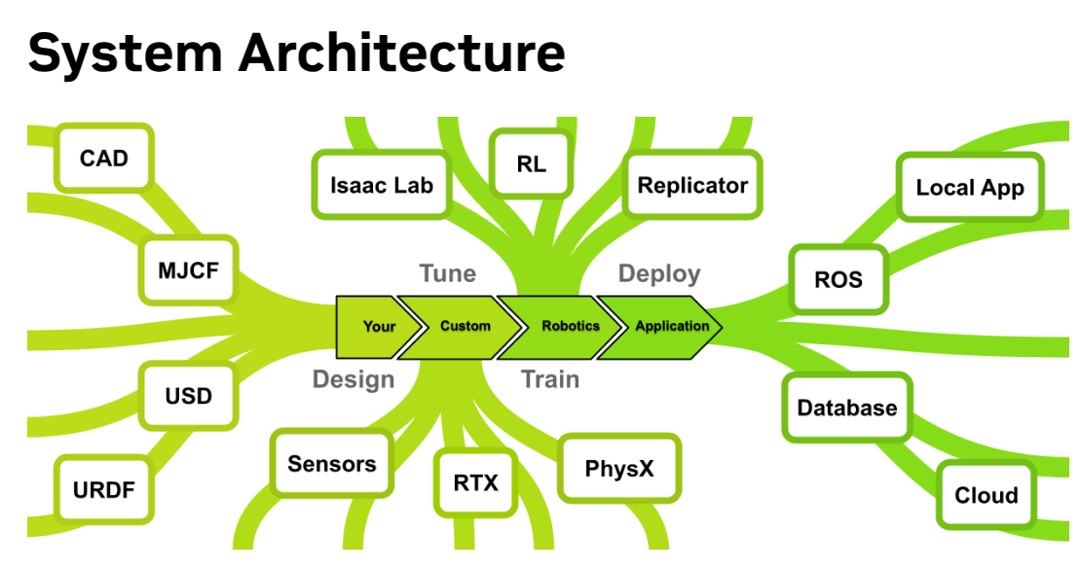
RL is a very computationally intensive part of this development pipeline

Slide 6
Reinforcement Learning Background
Once the robot is accurately modeled in simulation, RL training is setup based on a defined task goal
Example:
With a humanoid, walk forward at 2 m/s
Definitions:
Policy: Function defining agent's behavior based on a certain state
Observation Space: What the agent sees, such as joint angles & velocities, passed into a policy network
Action Space: The policy output, such as joint positions
Reward: How to determine good or bad behavior, updating the policy to maximize rewards

Slide 7
RL Computation on GPUs
Isaac Lab's rl_games framework for training uses PyTorch with CUDA backend
Environment Simulation uses PhysX drivers on GPUs, providing accurate joint controls, rigid body dynamics
Training a policy requires running thousands of environments in parallel on CUDA cores, processing observations
Large memory consumption as each environment possesses individual states
Ex: 10,000 parallel environments, with 1,000 iterations storing the observations, actions, rewards at each step

Slide 8
Experiment 1: Strong Scaling
Constants:
Task: Isaac-Cartpole-Direct-v0, Keep pole upwards on a cart
RL Framework: rl_games
Acceleration with PyTorch Distributed NCCL
# Environments: 4096
CPU: Intel Xeon Gold, 36 cores
GPU: L40
I.V:
# of GPUs
D.V:
Performance Metrics:
FPS Step- policy's decision-making speed
Environment Step– complete state, action, new state
FPS Total- cost of all systems
Time per Epoch

Slide 9
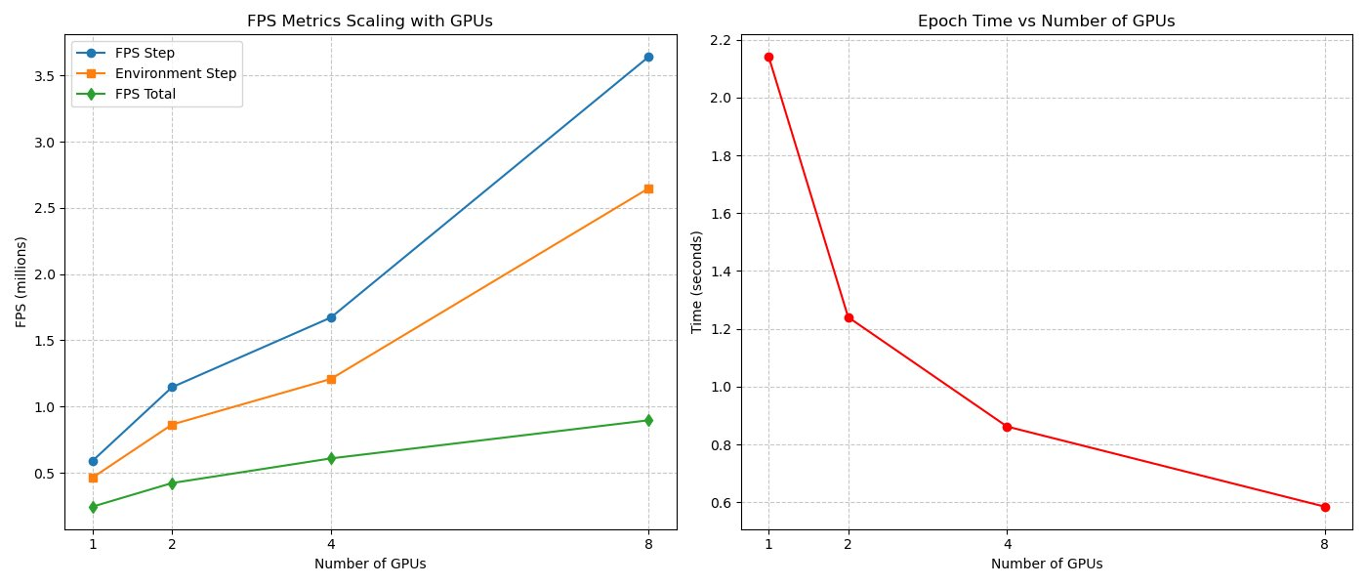
Results
Good Strong Scaling
NCCL communication for GPU-GPU overhead increases
Cartpole isn't as complex of a task
Left CPU OMP_NUM_THREADS at 1

Slide 10
Experiment 2: Weak Scaling
Constants:
Task: Isaac-Ant-v0, Moving towards a direction
RL Framework: rl_games
Acceleration with PyTorch Distributed NCCL
CPU: Intel Xeon Gold, 72 cores
GPU: L40
I.V:
# of GPUs
# of Environments
D.V:
Performance Metrics:
FPS Step- policy's decision-making speed
Environment Step– complete state, action, new state
FPS Total- cost of all systems
Time per Epoch

Slide 11
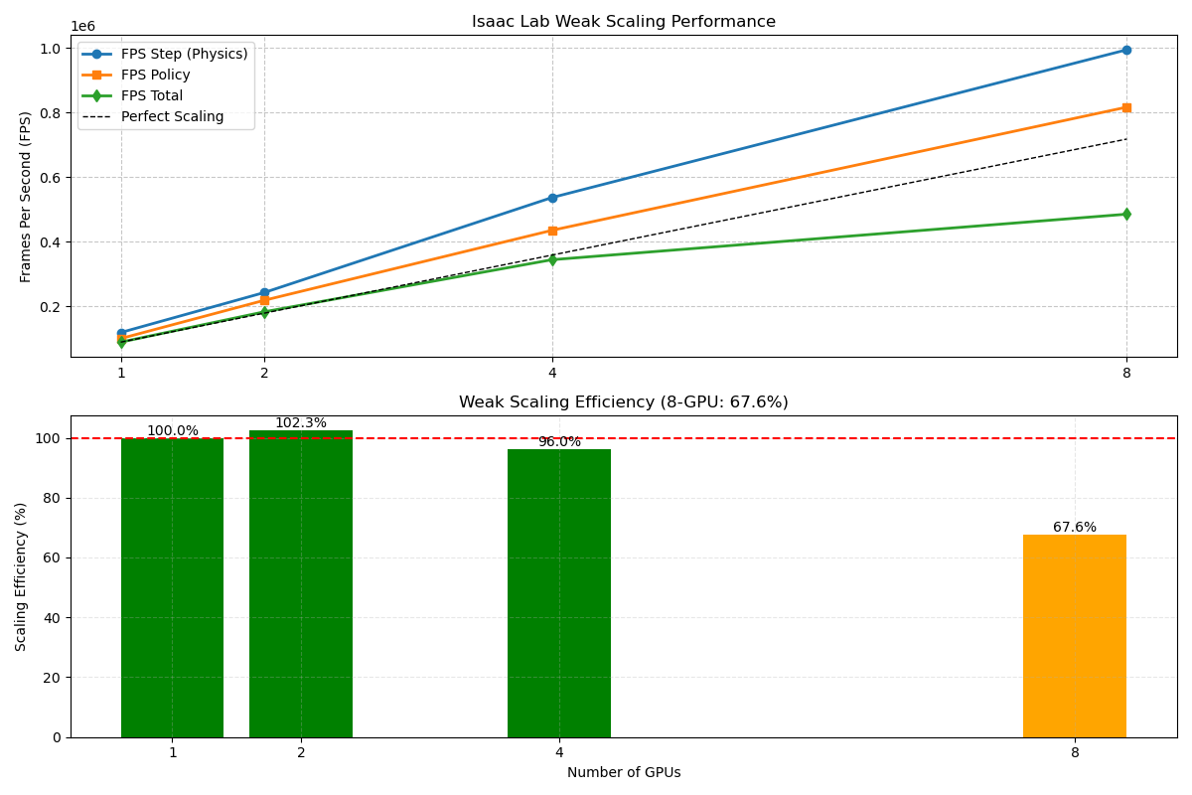
Results
Plan on using Nvidia Nsight for better analysis
Good scaling performance on L40 GPUs up to 8 GPUs for complex task
CPU bottlenecks during environment rollouts
NCCL communication overhead

Slide 12
Experiment 3 (In Progress): Comparing Different GPUs
In Progress
Writing a bash script for training deployment with Nvidia Nsight profiling
Assessing the value of different cores on training of a specific task
RT Cores (required for Isaac Sim)
Ray-tracing for simulation, including LiDAR sensors, and useful for RTX-rendered environments
Tensor Cores
Neural network inference/training for the policy
CUDA cores
General purpose

Slide 13
Final Outcomes & Thoughts
Very beneficial learning experience for an important technology and how HPC applies to it
Worked through several different errors
Initial Installation since Isaac Sim steps use a GUI
Some tasks require RTX-support for PhysX, others don't
Not all frameworks greatly benefit from GPU acceleration
Without previous RL understanding, it was difficult to understand how to interpret certain results
Benchmarking scripts were provided but wasn't as well document or easy to use
Understanding differences in efficiency between tasks requires better detail about how it works

